Slide 1
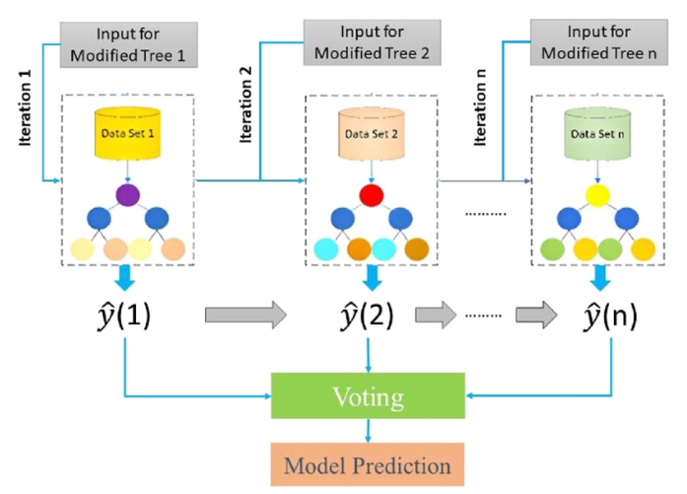
XGBoost
XGBoost is a supervised machine learning method for classification and regression and is used by the Train Using AutoML tool.
XGBoost is short for extreme gradient boosting. This method is based on decision trees and improves on other methods such as random forest and gradient boost.

Slide 2
XGBoost
XGBoost, short for Extreme Gradient Boosting
Supervised learning algorithm
XGBoost is used for regression and classification problems
Do not require feature scaling
Not sensitive to outliers
Handling missing values by default
Decision-tree-based ensemble ML algorithm
Sequential ensemble learning

Slide 3
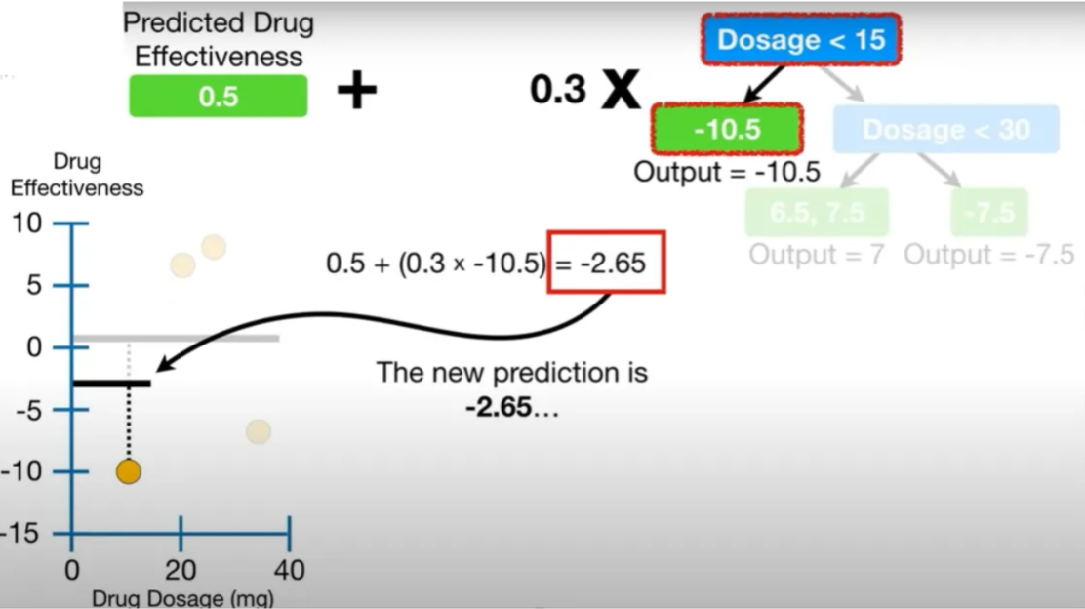
XGB Regressor
The XGBRegressor generally classifies the order of importance of each feature used for the prediction.
A benefit of using gradient boosting is that, after the boosted trees are constructed, it is relatively straightforward to retrieve importance scores for each attribute.

Slide 4
How it works ?
Initial Prediction
Error Calculation
Building the First Decision Tree
Stopping Criteria
Subsequent Trees and Error Correction
Minimizing Loss Function

Slide 5
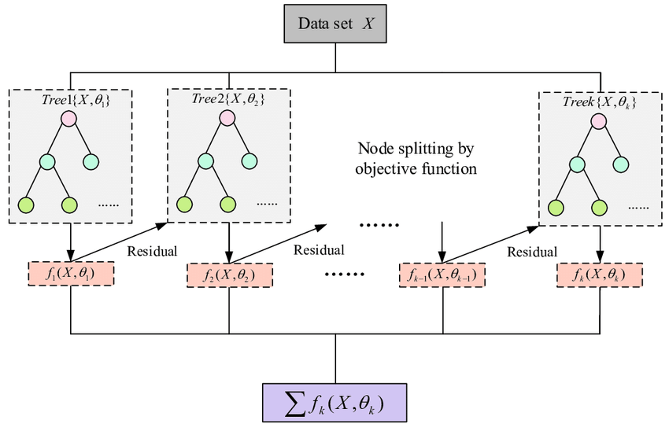
XGBoost

